Slide 1
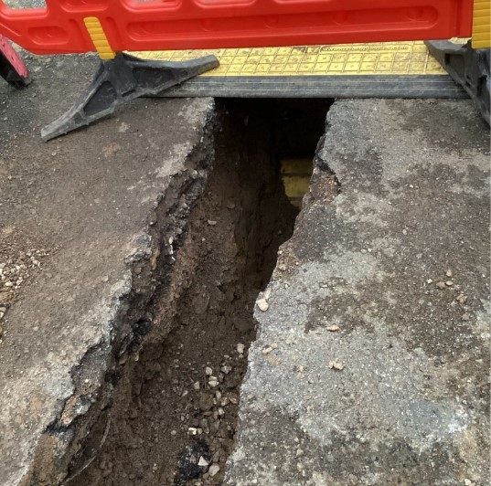
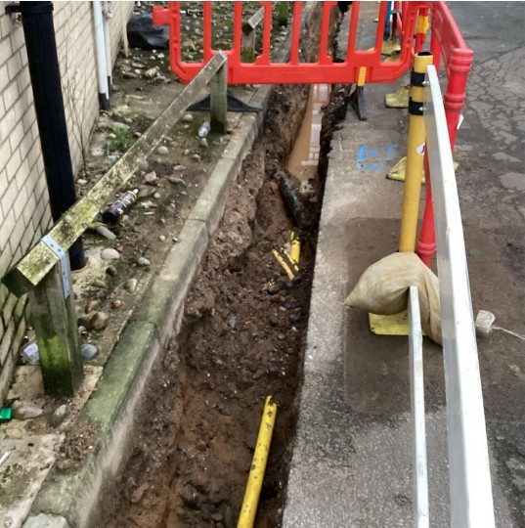
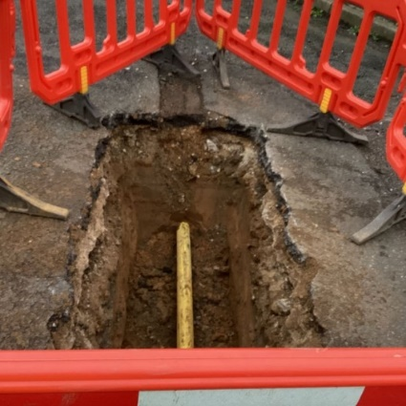
Brookhill Close Newsletter
Thursday 11 January 2024
Dear Residents,
From everyone at Wates and Hyde we hope everyone had a wonderful festive season and a Happy New Year!
We’ll be starting to disconnect the electricity on site next week. This shouldn’t affect supplies to your homes.
Southern Gas Networks are continuing to disconnect the gas at Brookhill Close. This won’t affect access to and from Brookhill.
If you know of any local community events happening this month to kickstart the year, please send us the details and perhaps we can share them in the newsletter or place them on our community board.
If you have any questions, please contact our Resident Liaison Officer,
Paris Gardner:
Telephone: 07754049321
Email: Paris.Gardner@wates.co.uk
Yours
The Wates Team

